Slide 1
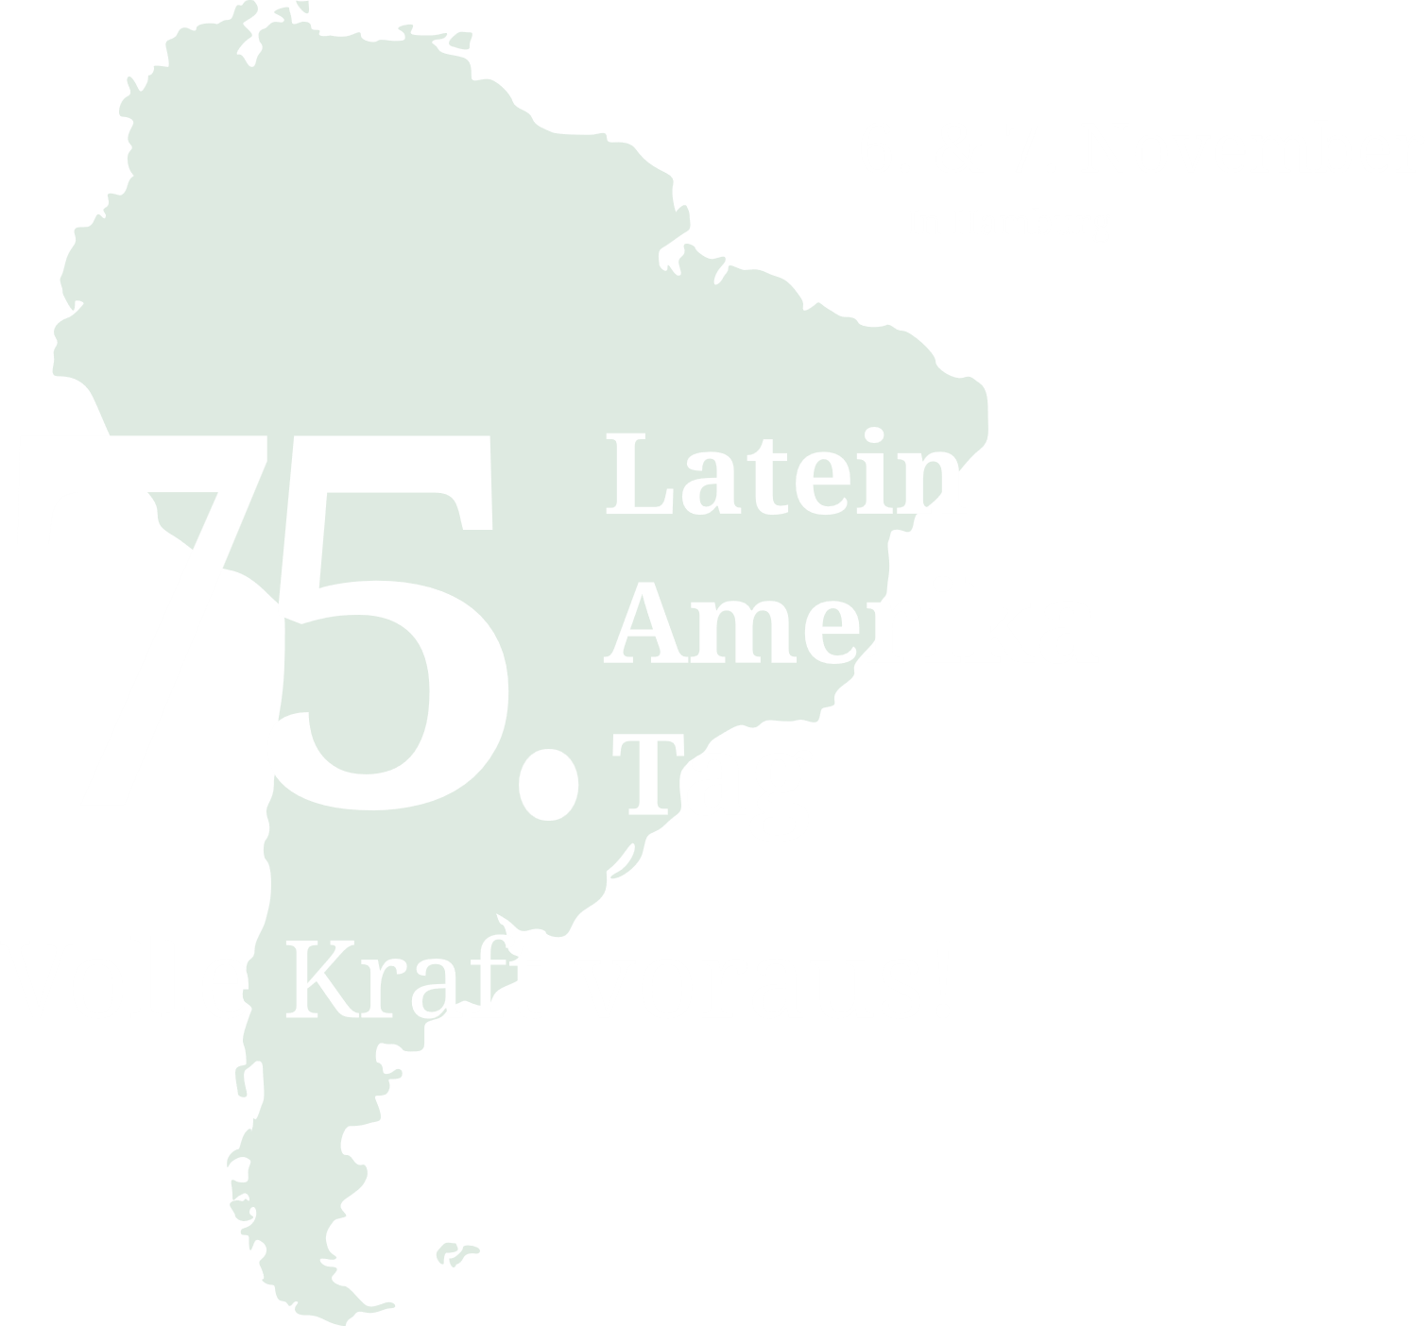
75th Latin America Day
Hamburg, Germany
Maria Luisa Hayem Brevé Minister of Economy EL SALVADOR | Gabriela García Minister of Economy GUATEMALA

Slide 2
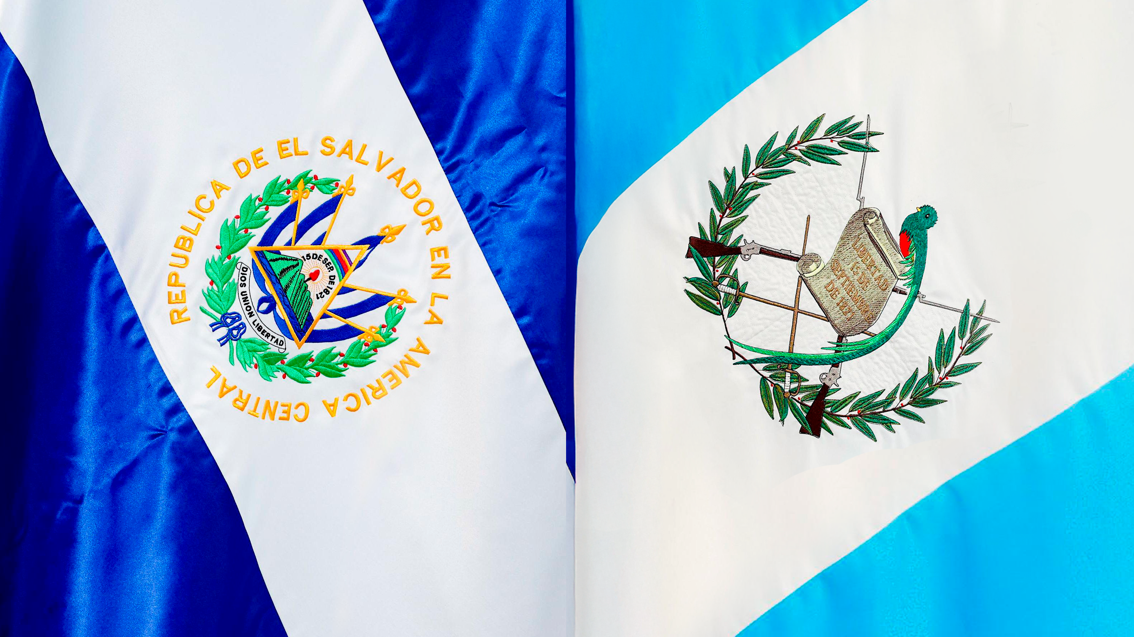

EL SALVADOR AND GUATEMALA

Slide 3
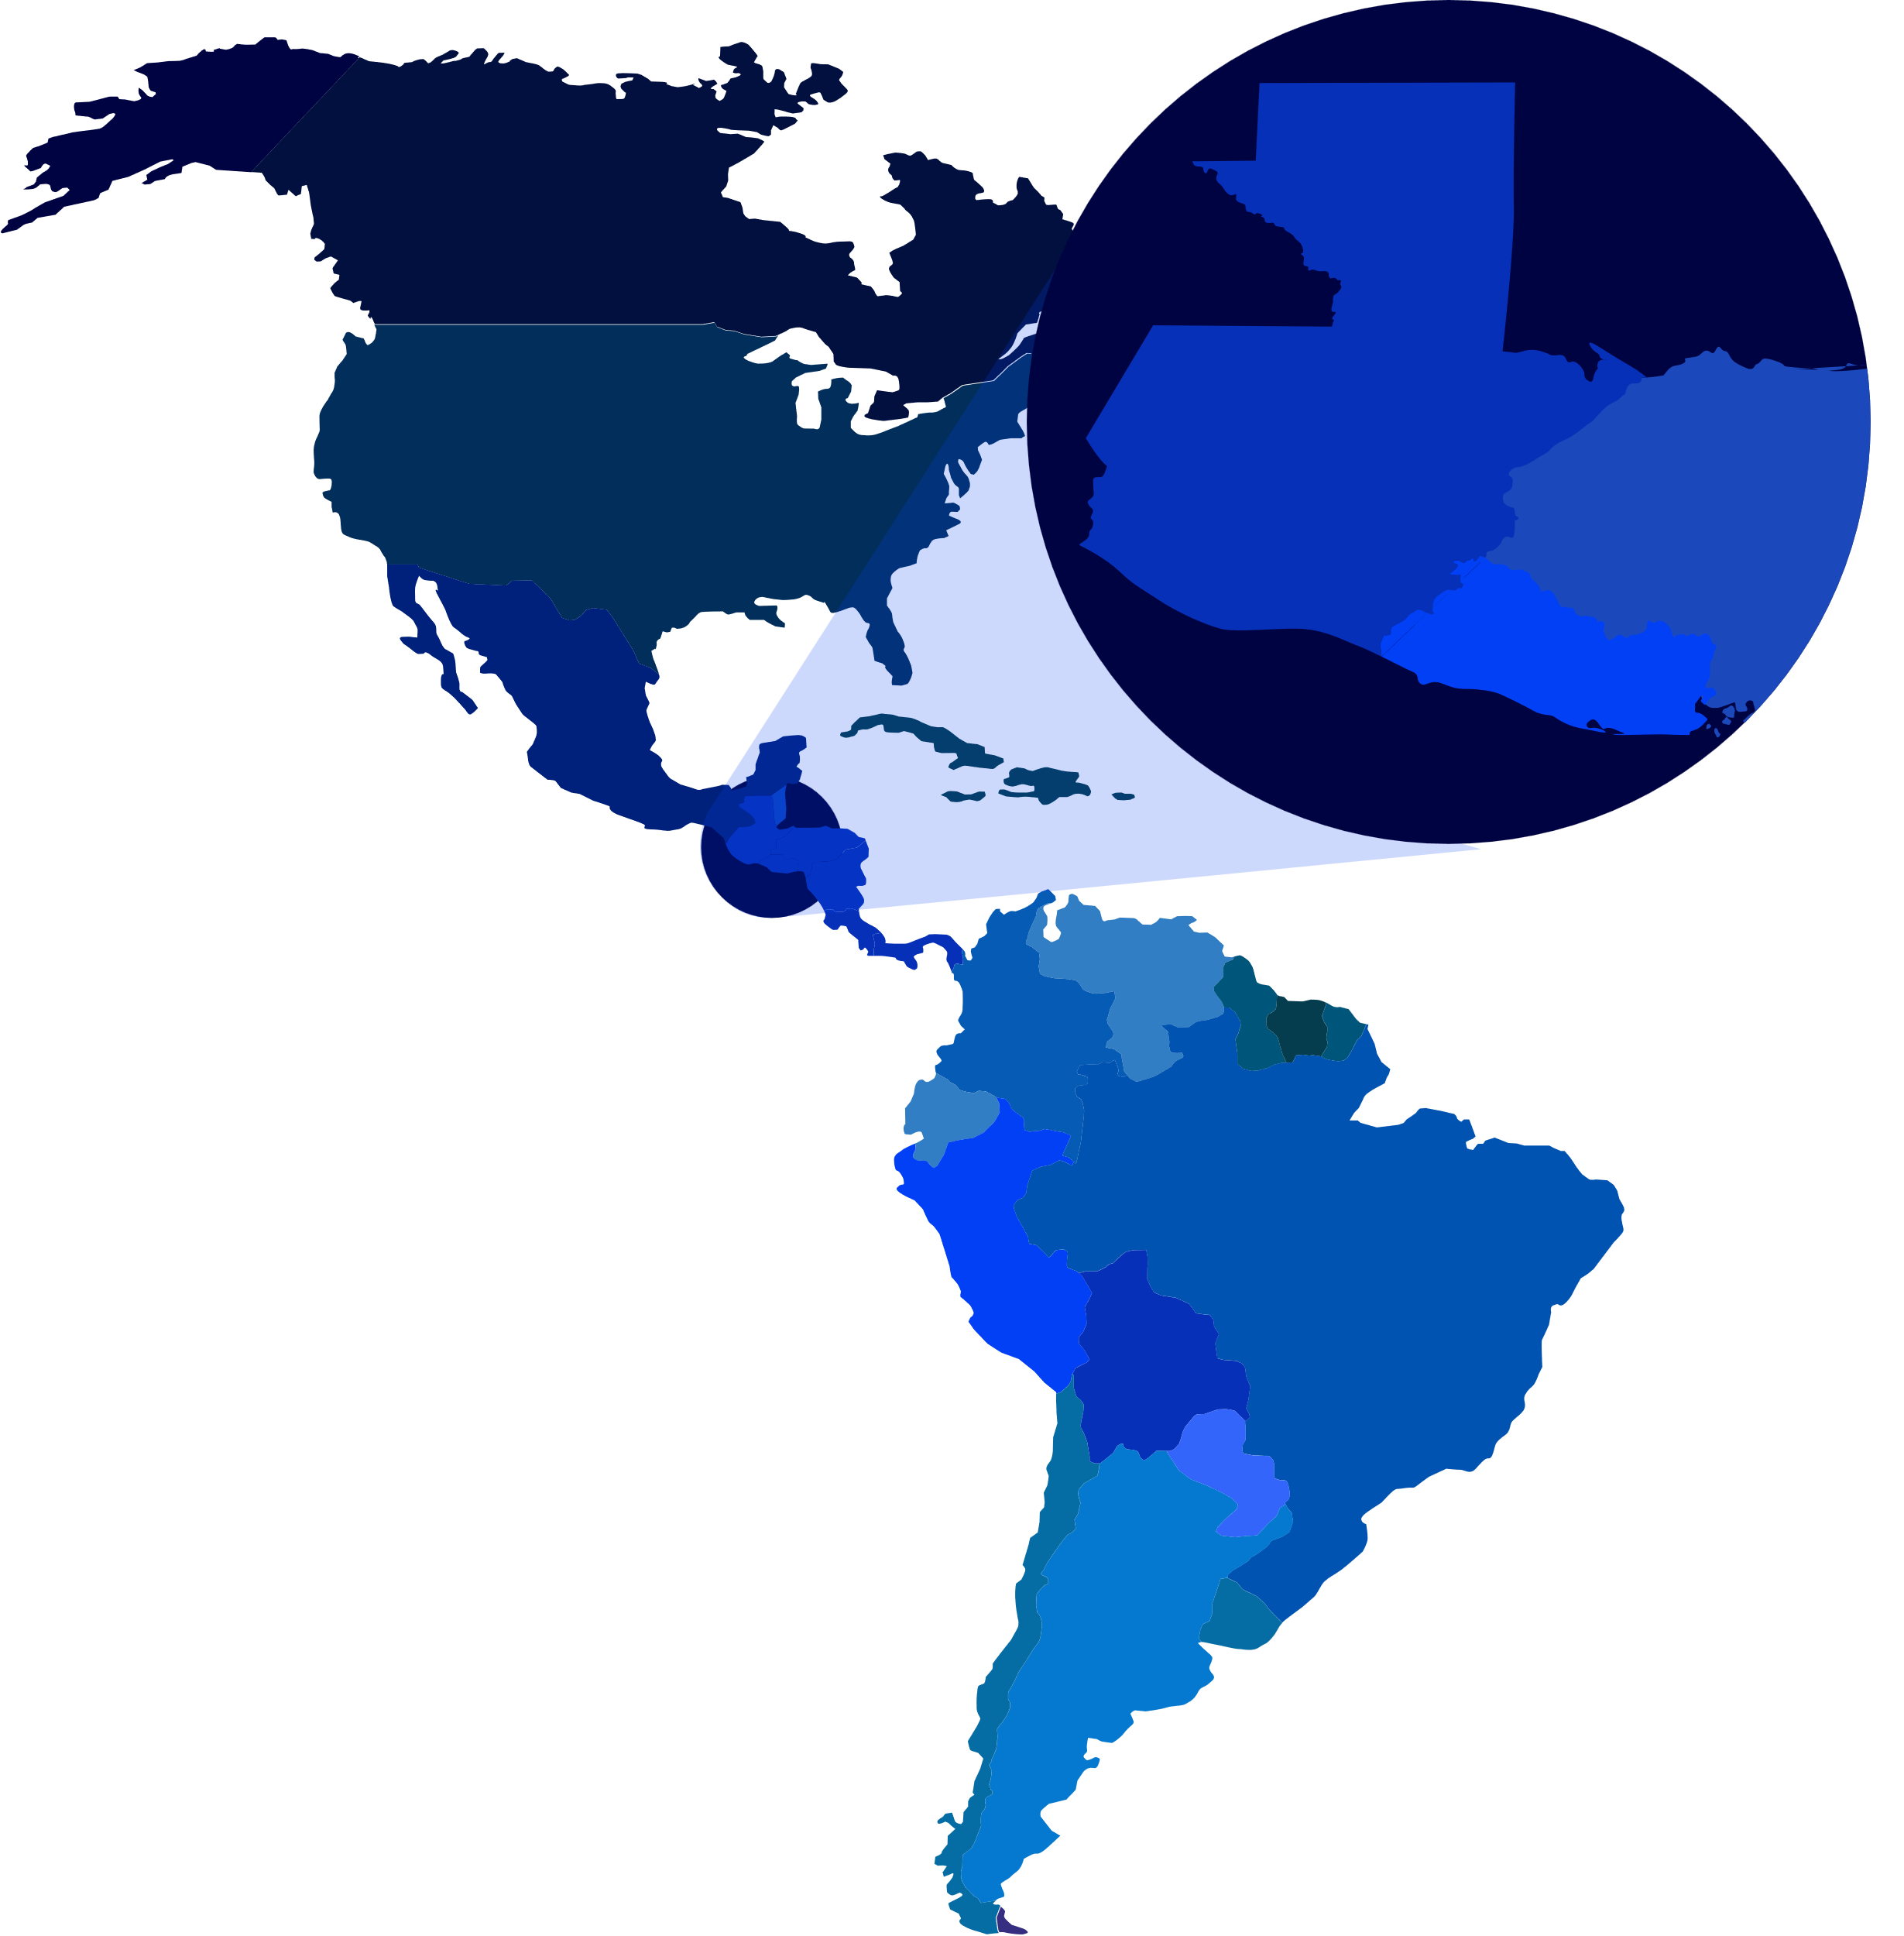
GUATEMALA AND EL SALVADOR
Population: 24 million inhabitants
Territory: 130,000 km²
GDP: USD 136 billion
Private investment: USD 22 billion
Economic growth for both countries: 3.5%
Data to 2023
Source: Central Reserve Bank of El Salvador and Bank of Guatemala

Slide 4








EL SALVADOR AND GUATEMALA
INVESTMENT DESTINATION
Talent: our greatest asset
Energy from environmentally friendly sources
Macroeconomic stability
Modern and competitive infrastructure
Modern regulatory framework and incentives that stimulate production
Common Trade Agreements
Strategic location that connect us with North and South America

Slide 5




OUR FTAS ALLOW US TO ATTRACT MORE
INVESTMENT FROM KEY MARKETS
Access to the European market, through the Association Agreement between the European Union and Central America
Free Trade Agreement with the United States, the largest market in the world.
Gateway to the largest market in Latin America: Mexico.
Preferential access to the Central American market.

Slide 6
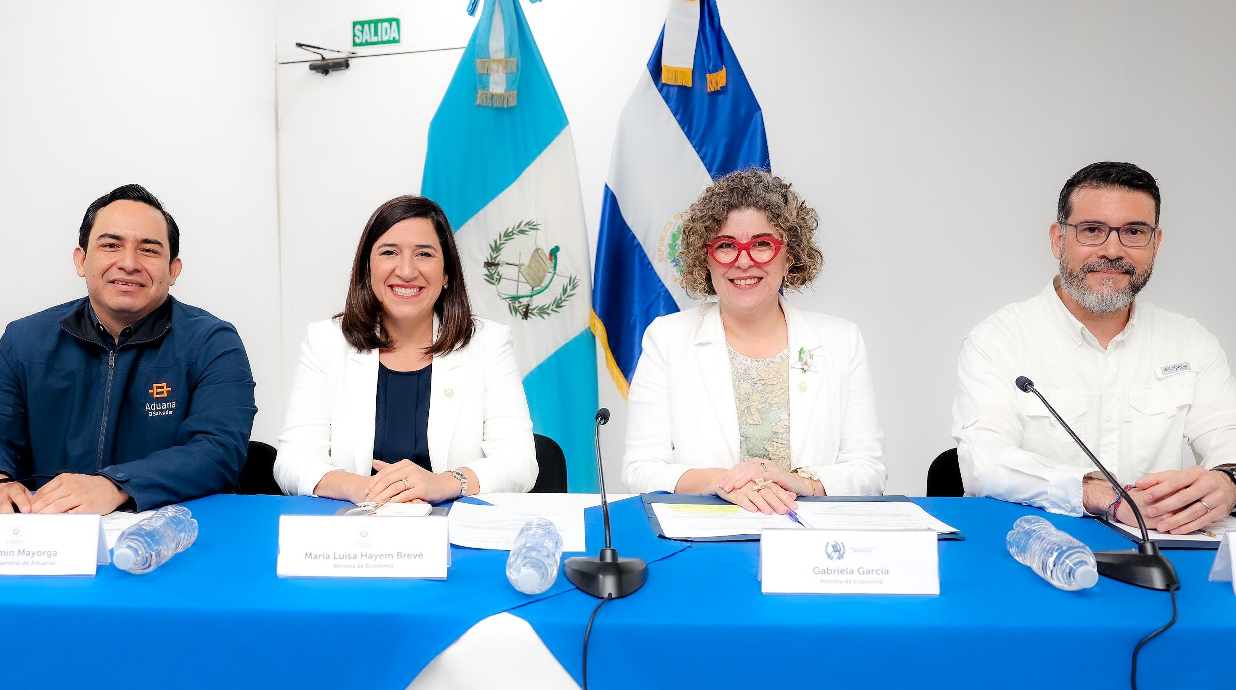
CUSTOMS INTEGRATION

Slide 7

CUSTOMS INTEGRATION
This process implemented between El Salvador and Guatemala establishes the creation of a single customs territory
Contributes to facilitate the transit of goods by reducing response times of border operations
Guatemala and El Salvador are working to implement this process on four common borders
90% of merchandise will benefit from “free circulation” between El Salvador and Guatemala
98% tariff harmonization with third countries

Slide 8

COMMON PRIORITIZED SECTORS OF
GUATEMALA AND EL SALVADOR

Slide 9







SECTORS
Pharmaceuticals and chemicals
ICT and software
Food and beverages
Medical devices and equipment
Tourism services and infrastructure
Auto parts
Electronic components and equipment

Slide 10

SPECIALIZED SERVICES
THROUGH THE INVESTMENT ATTRACTION AGENCIES
OF BOTH COUNTRIES

Slide 11




Our Investment Attraction Agencies Specialized Services
1
Investment Intelligence
2
Professional Advisors
3
Softlanding and Aftercare
Services
4
Business Agendas with Key Partners
Detailed country information for the investment decision-making process
Specialized assistance to foreign investors.
One-on-one technical assistance
Follow-up for the establishment of new investment projects and for the expansion of existing projects
Customized Agendas for linkage with public and private entities and key stakeholders for investment projects

Slide 12


CONTACT US
Laura Rosales de Valiente
Deputy Director for Business Facilitation
+503 7070 6523
lrosales@economia.gob.sv
Beatriz Sanchez Patzan
Foreign Direct Investment Advisor
+502 5500 8590
mbsanchezp@mineco.gob.gt

Slide 13



